Slide 1
"Enhancing Road Safety through Automated Pothole Detection"
Team Details
E. Sree Harsha (20EG110105)
J. Buvann (20EG110111)
N. Dyuthi Reddy (21EG510103)
Project Supervisor
Name: Mrs. G. Swapna
Assistant Professor
Department of Data Science

Slide 2
Abstract
Potholes are a major cause of accidents and injuries on road, and there is a growing need for new technologies to improve road safety. Object detection using deep learning is a promising new approach that can be used to identify potholes. The system will use a camera to capture images of road, and a deep learning model will be used to detect objects such as potholes, depth and size. The system will then be able to generate alerts if it detects any of the objects. The system will be evaluated on a data set of images from real-world environments .We will measure the accuracy of the system in detecting objects and hazards, and we will also evaluate the system's ability to generate timely alerts.

Slide 3
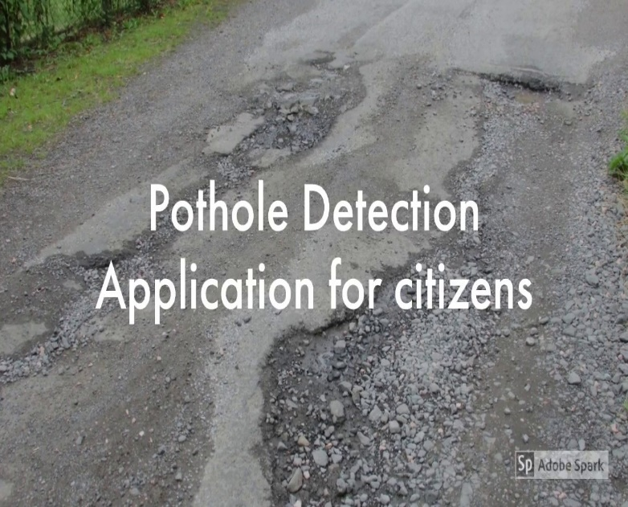
Introduction
Potholes are a major safety hazard for road users and can incur significant costs for road maintenance.
This project describes about pothole detection system that uses computer vision and machine learning to identify potholes in real time.
The system uses cameras to collect images of the road surface, which are then pre-processed to enhance their quality.
A machine learning model is used to classify the images as either containing a pothole or not. The system can detect potholes with high accuracy and in real time, and it can also generate alerts regarding the depth of potholes.

Slide 4
Literature
Author(s) | Method | Advantages | Disadvantages
Xinke Li and Yongcai Guo (2019) | PSO-SVM algorithm | Utilizing PSO with SVM improves defect classification accuracy by optimizing parameters and offers automated tuning for efficiency. It enhances robustness to noisy data and efficiently explores parameters while maintaining interpretability, making it a practical solution for ensuring cable-stayed bridge safety and maintenance. | It is complex implementation, computational intensity, Hyperparameter Sensitivity
Wang et al (2019) | YOLOv3 network | The system is robust to changes in the environment, such as the appearance of objects and the lighting conditions. The system is easy to deploy | The system is not suitable for all industrial safety applications, such as system may not be able to detect small objects or objects that are moving quickly.

Slide 5
Problem Statement
Addressing the pressing issue of road accidents and injuries caused by potholes, this project seeks to develop an object detection system using deep learning for road safety. The challenge is to create a system that accurately identifies and categorizes road hazards, including potholes, utilizing image data from real-world environments, and generates timely alerts to mitigate potential dangers. The project aims to demonstrate the feasibility of employing deep learning-based object detection to significantly enhance road safety and reduce accident rates.
Objective
Here we are using Yolov8 network to obtain the solution. It is mainly used for fast detections and to provide accurate results.
The following are the outcomes that will be obtained :
Enhance road Safety
Real-time Monitoring
pothole Detection
Testing and Validation
Reporting

Slide 6
Proposed Method
The proposed solution is to use YOLOv8 to develop a video analytics system for road safety that is specifically designed to address the challenges of road safety. The system will be trained on a large dataset of videos that are representative of the types of environments and objects that will be encountered on roads. .
Benefits: The proposed solution would have a number of benefit
Improved accuracy
Increased safety
Reduced costs

Slide 7
Proposed Method
The proposed system will be implemented in four phases:
Data collection and preparation
Model training
reporting
System deployment
Conclusion: The proposed project would develop a video analytics system for road safety using YOLOv8. The system would be more accurate than current solutions and would have a number of benefits, including improved safety, reduced costs, and increased efficiency.

Slide 8
Tools And Technologies
HARDWARE REQUIREMENTS
SYSTEM : PENTIUM IV 2.4 GHZ
HARD DISK : 40 GB
RAM : 512 MB
SOFTWARE REQUIREMENTS
OPERATING SYSTEM : WINDOWS 10
CODING LANGUAGE : PYTHON

Slide 9
Work Flow
Video Capture
Pothole Detection
Report generation

Slide 10
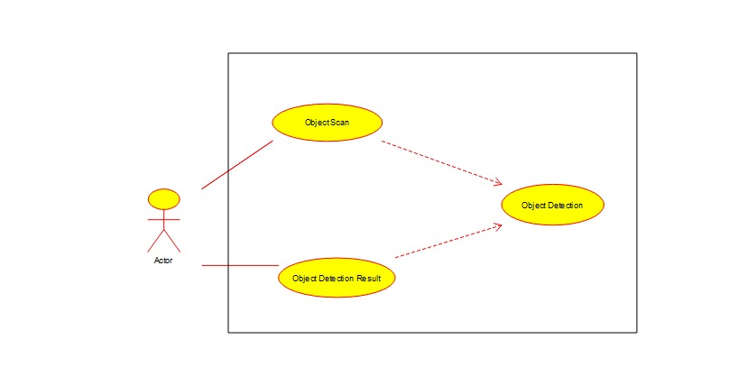
Use Case

Slide 11
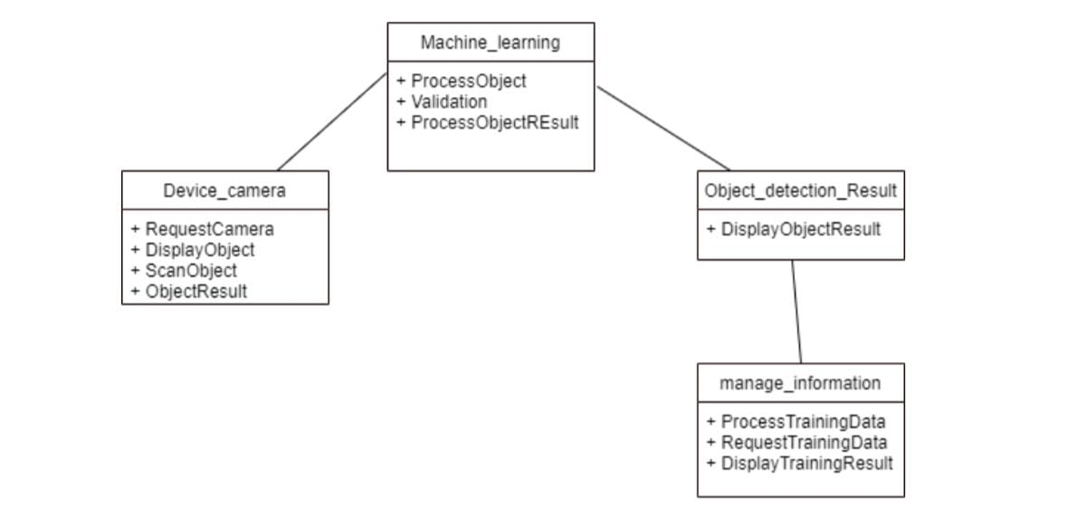
Class Diagram

Slide 12
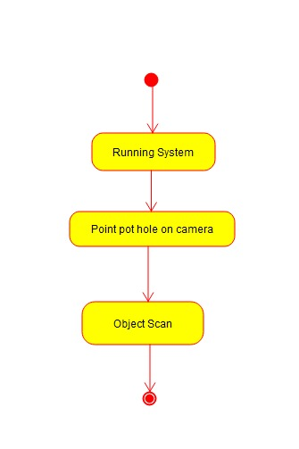
Activity Diagram
1.Object Scan

Slide 13
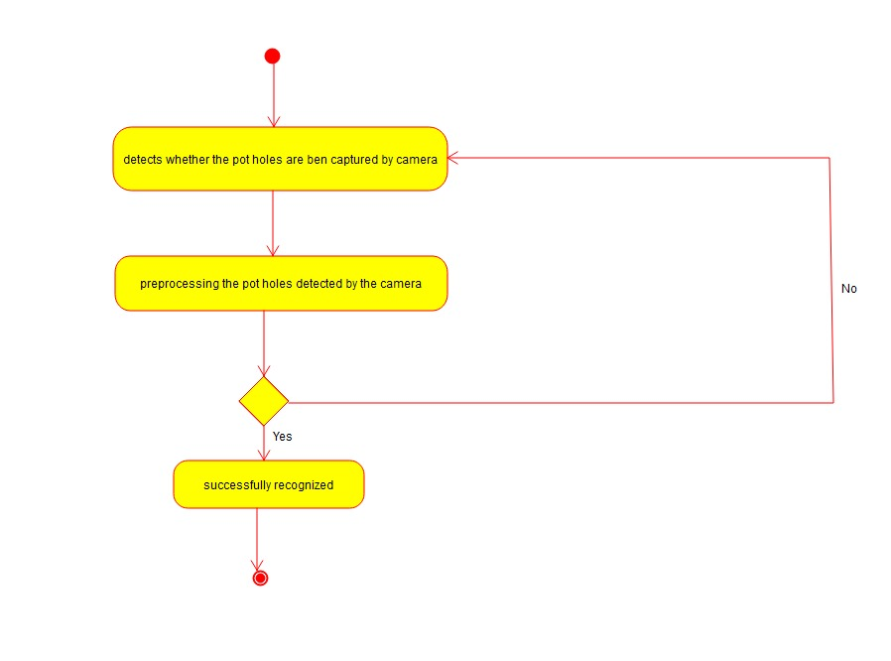
Activity Diagram
2.Object Detection

Slide 14
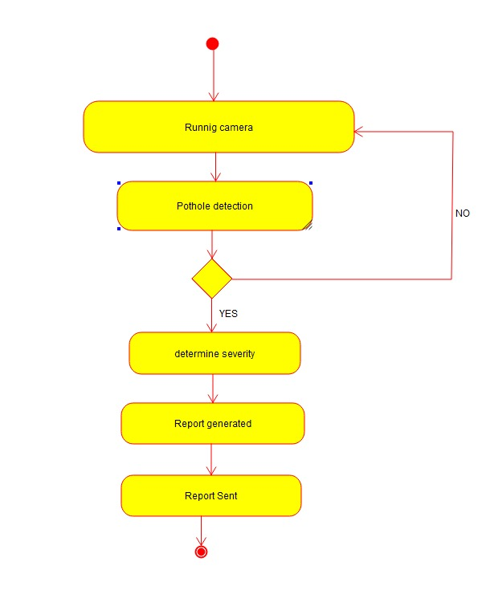
Activity Diagram
3.Object Detection Result

Slide 15
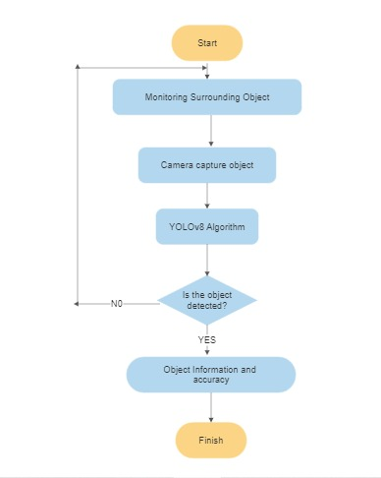
Flow Chart

Slide 16
Implementation
Here we are using YOLOv8( You Only Look Once version 8) algorithm to train the model
Here the potholes are identified as an object
The algorithm takes the input from the camera and then detects for potholes and if there are any potholes that are present the system shows for the potholes. In this way the potholes are detected
And all this process is done within split seconds of time

Slide 17
Sample Code
# Pip install method (recommended)
!pip install ultralytics==8.0.20
from IPython import display
display.clear_output()
import ultralytics
ultralytics.checks()
from ultralytics import YOLO
from IPython.display import display, Image
%cd /content/drive/MyDrive/Pothole.v1-raw.yolov8
!yolo task=detect mode=train model=yolov8s.pt data= data.yaml epochs=100 imgsz=224 plots=True
from google.colab import drive
drive.mount('/content/drive')
Image(filename='runs/detect/train/confusion_matrix.png', width=600)
Image(filename='runs/detect/train/val_batch0_pred.jpg', width=600)

Slide 18


Slide 19
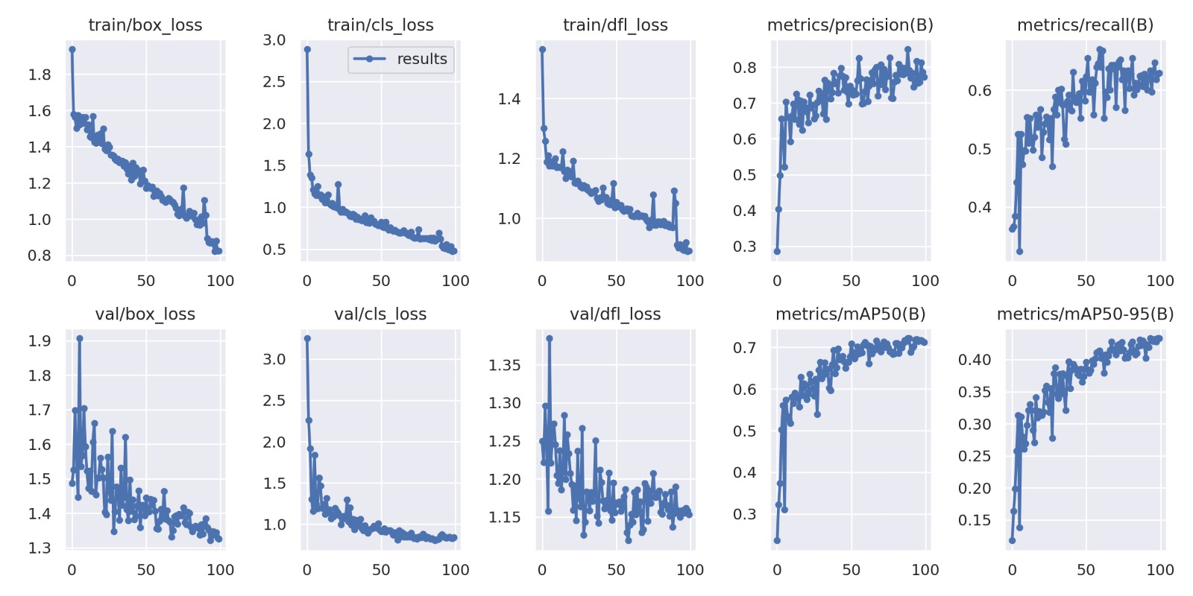
Screenshots of Execution

Slide 20
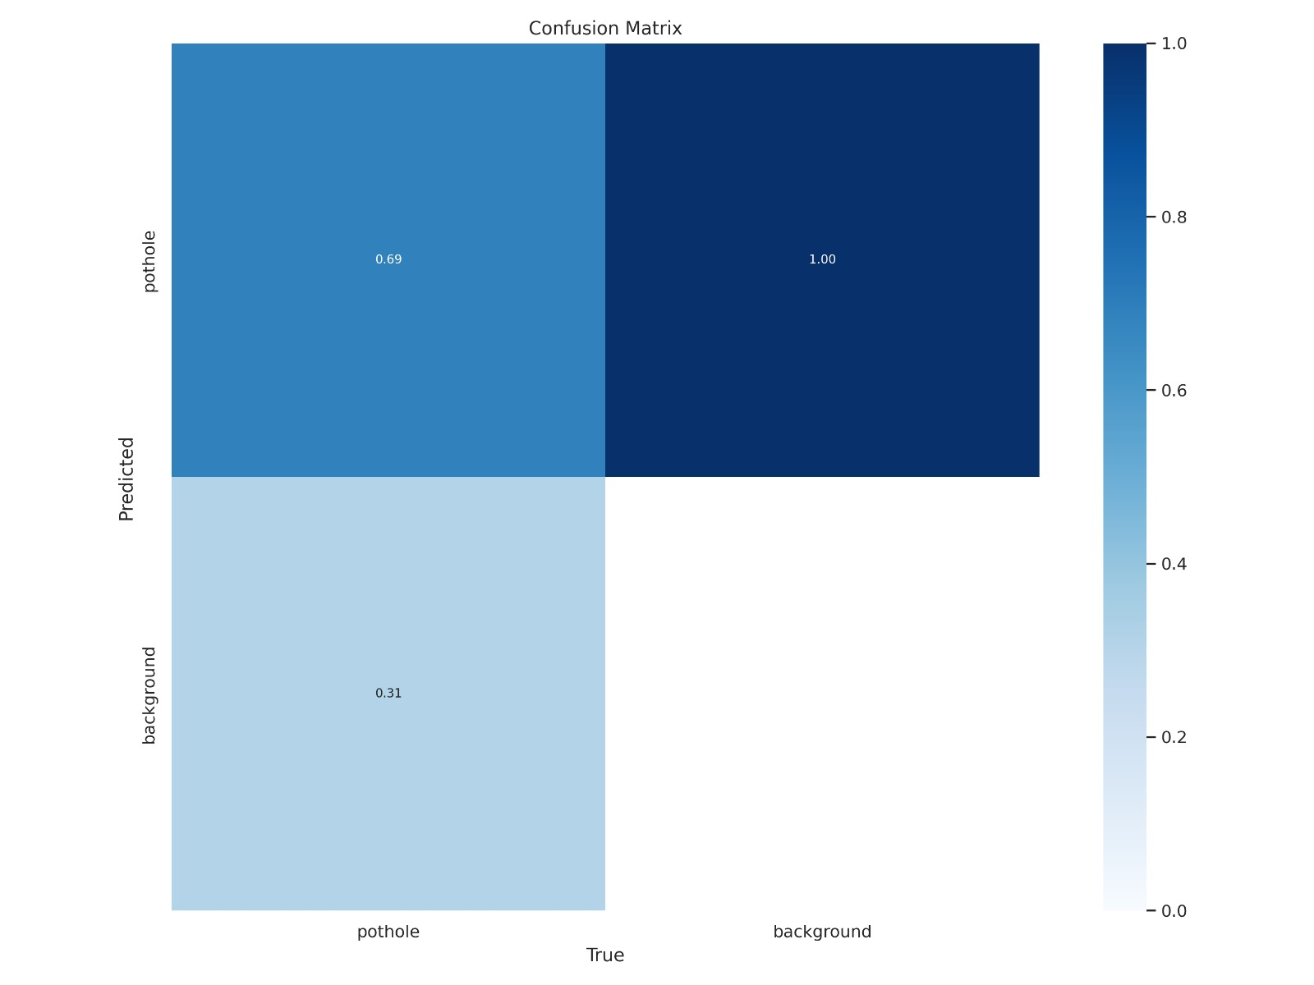
Confusion matrix for the result

Slide 21
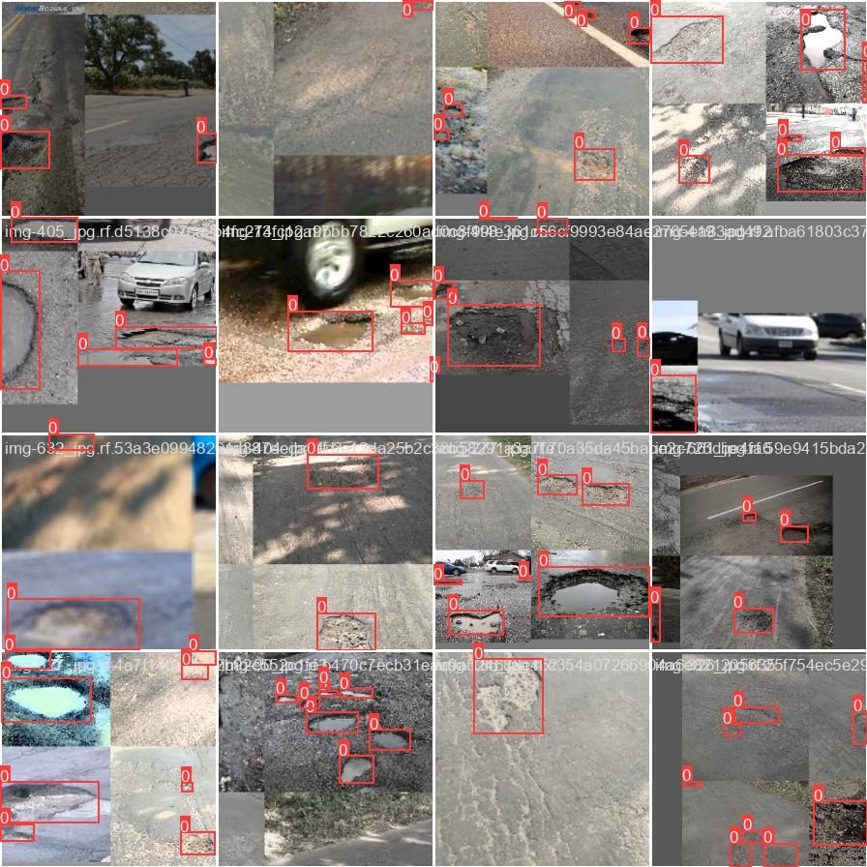
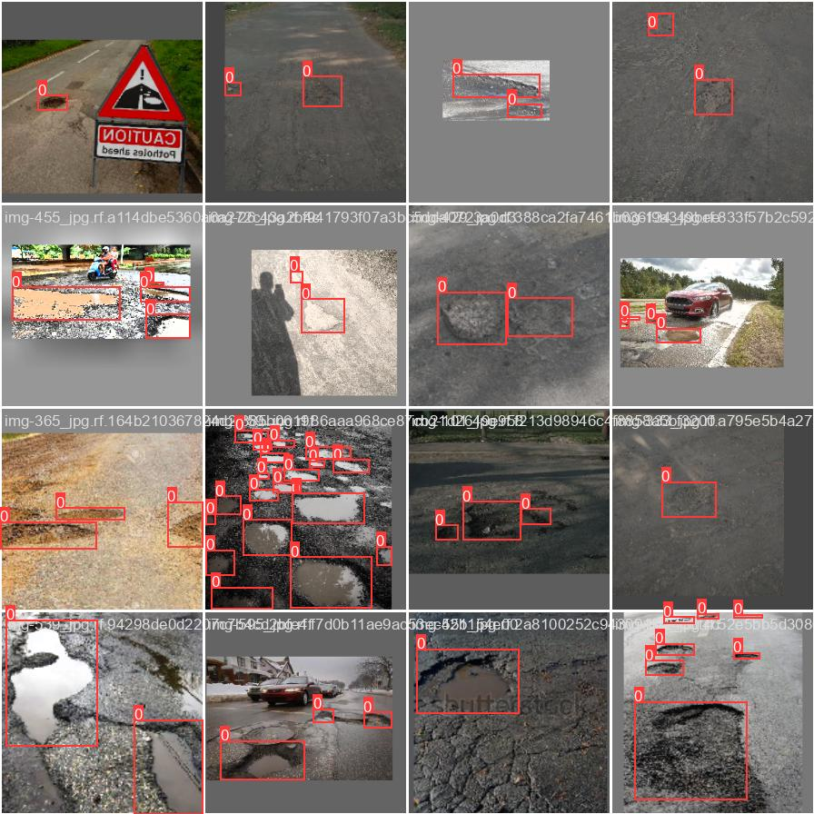

Slide 22
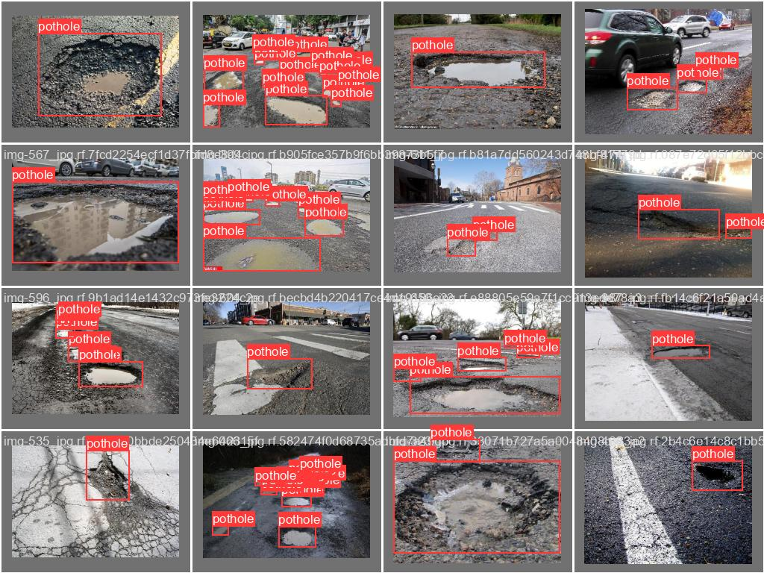

Slide 23
References
N. Silva, J. Soares, V. Shah, M. Y. Santos and H. Rodrigues, "Anomaly detection in roads with a data mining approach", Procedia Comput. Sci., vol. 121, pp. 415-422, Jan. 2017.
A. Mohan and S. Poobal, "Crack detection using image processing: A critical review and analysis", Alexandria Eng. J., vol. 57, no. 2, pp. 787-798, Jun. 2018.
J. Masino, J. Thumm, M. Frey and F. Gauterin, "Learning from the crowd: Road infrastructure monitoring system", J. Traffic Transp. Eng., vol. 4, no. 5, pp. 451-463, Oct. 2017.

Slide 24
THANKYOU

